Slide 1
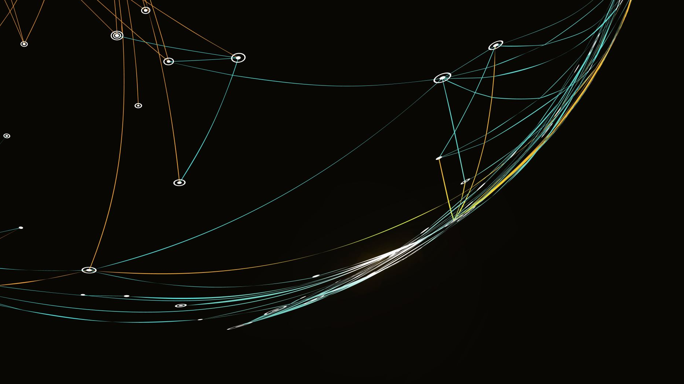
ICTWEB513 – Build Dynamic Websites
1.2 Programming Control and Design Structures

Slide 2
Structured Programming
Programs are broken down into different functions. Also known as: modules, subprogram, subroutines or procedures.
Each function is designed to do a specific task with its own data and logic.
Information is passed to the function through parameters.
Clarity – easy to read and maintain
Reusability – development is easier as it requires less time and effort
Easier to debug

Slide 3
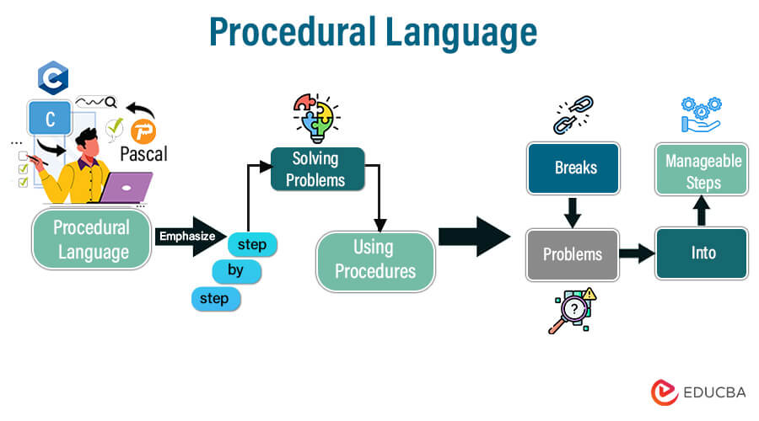
Types of Structured Programming
Procedural programming – consists of writing sequence of instructions that perform a specific task into groups called “modules”, “procedures” or “functions”.
Common examples of procedural languages include:
C and C++
Java
Pascal
BASIC

Slide 4
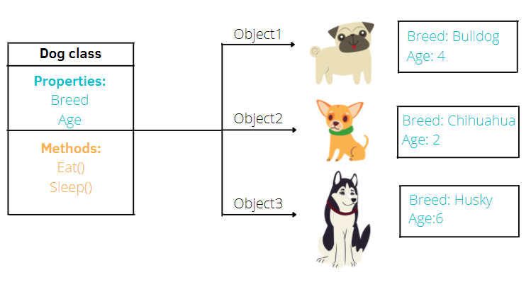
Types of Structured Programming
Object-Oriented programming (OOP) – programs are composed of data (attributes) and functions (methods).
Objects can be reused within a program or in other programs.
Common examples of procedural languages include:
Java
Python
PHP
C++
Ruby

Slide 5
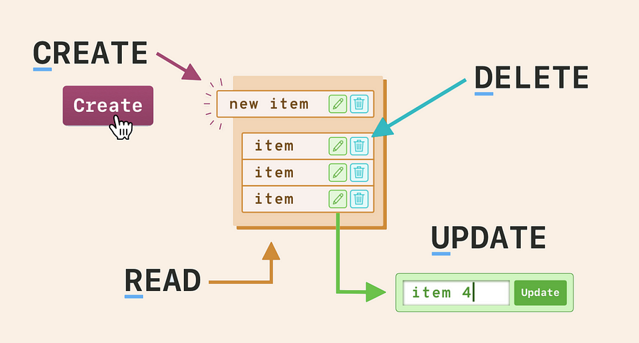
Types of Structured Programming
Model-based programming – the code is organized around the steps or operations defined by the underlying model, and units of code are associated with these steps.
Database query language – the structure of the code is determined by the structure of the database and its access methods
SQL (Structured Query Language): where units of code are associated with database operations such as SELECT, INSERT, UPDATE, and DELETE

Slide 6
Structured Programming
Typically have a header file that describes the modules and libraries referenced and the structure of the parameters and module interface.
Abstraction – an interface description is provided in a separate file which is then implemented into one or more units of code.

Slide 7
Program Control
Program control – determines the flow of data
If statements
Loops
Variables/Arrays
Data transfer between pages
SQL design

Slide 8
PHP Data Types
String – is a sequence of characters
Integer – is a non-decimal number between -2,147,483,648 and 2,147,483,647.
Float (floating point numbers - also called double) – is a number with a decimal point or a number in exponential form
Boolean – represents two possible states: TRUE or FALSE.
Array – stores multiple values in one single variable.
Object – Classes and objects are the two main aspects of object-oriented programming.
NULL – is a special data type which can have only one value: NULL. A variable of data type NULL is a variable that has no value assigned to it.

Slide 9
JavaScript Data Types
String – represents textual data
Number – an integer or a floating-point number
Boolean – Any of two values: true or false
null – a variable that has no value assigned to it
undefined – a data type whose variable is not initialized

Slide 10
SQL Data Types
Has three main data types: string, numeric, and date and time.

Slide 11
SQL NUMERIC Data Types
BOOL | Zero is considered as false, nonzero values are considered as true.
BOOLEAN | Equal to BOOL
INT(size) | A medium integer. Signed range is from -2147483648 to 2147483647. Unsigned range is from 0 to 4294967295. The size parameter specifies the maximum display width (which is 255)
INTEGER(size) | Equal to INT(size)
FLOAT(size, d) | A floating-point number. The total number of digits is specified in size. The number of digits after the decimal point is specified in the d parameter. This syntax is deprecated in MySQL 8.0.17, and it will be removed in future MySQL versions
DOUBLE(size, d) | A normal-size floating point number. The total number of digits is specified in size. The number of digits after the decimal point is specified in the d parameter
DEC(size, d) | Equal to DECIMAL(size,d)

Slide 12
SQL STRING Data Types
VARCHAR(size) | A VARIABLE length string (can contain letters, numbers, and special characters). The size parameter specifies the maximum string length in characters - can be from 0 to 65535
TEXT(size) | Holds a string with a maximum length of 65,535 bytes
BLOB(size) | For BLOBs (Binary Large Objects). Holds up to 65,535 bytes of data
LONGTEXT | Holds a string with a maximum length of 4,294,967,295 characters
LONGBLOB | For BLOBs (Binary Large Objects). Holds up to 4,294,967,295 bytes of data

Slide 13
SQL DATE & TIME Data Types
DATE | A date. Format: YYYY-MM-DD. The supported range is from '1000-01-01' to '9999-12-31'
DATETIME(fsp) | A date and time combination. Format: YYYY-MM-DD hh:mm:ss. The supported range is from '1000-01-01 00:00:00' to '9999-12-31 23:59:59'. Adding DEFAULT and ON UPDATE in the column definition to get automatic initialization and updating to the current date and time
TIMESTAMP(fsp) | A timestamp. TIMESTAMP values are stored as the number of seconds since the Unix epoch ('1970-01-01 00:00:00' UTC). Format: YYYY-MM-DD hh:mm:ss. The supported range is from '1970-01-01 00:00:01' UTC to '2038-01-09 03:14:07' UTC. Automatic initialization and updating to the current date and time can be specified using DEFAULT CURRENT_TIMESTAMP and ON UPDATE CURRENT_TIMESTAMP in the column definition
TIME(fsp) | A time. Format: hh:mm:ss. The supported range is from '-838:59:59' to '838:59:59'
YEAR | A year in four-digit format. Values allowed in four-digit format: 1901 to 2155, and 0000. MySQL 8.0 does not support year in two-digit format.

Slide 14
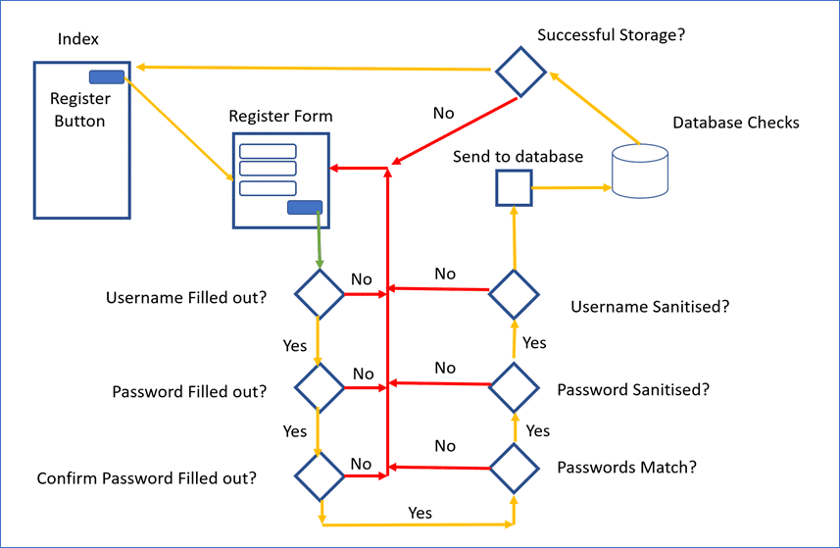
Flow of Data
With the advancement of the languages that we use to code, a lot of this is now automatic.

Slide 15
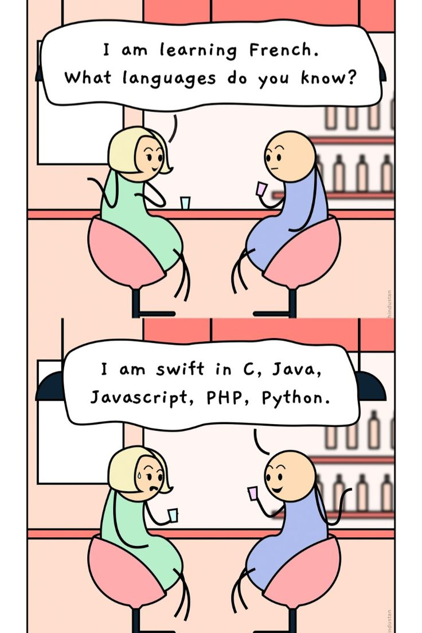


Slide 16
ICTWEB513 – Build Dynamic Websites
1.3 Web programming concepts, including: authentication and web security

Slide 17
Website Authentication
is the security process that allows users to verify their identities to gain access to their accounts on a website such as social media profiles, eCommerce sites, rewards programs, online banking accounts, and more.
Website authentication practices often include the creation of an ID and key.
ID and key are then stored in a highly secure web server.
Types of website authentication:
username and password as the ID and key (have become more vulnerable to cyber-attacks)
two-factor authentication (TFA – requires users of your website to provide, along with their standard username and password, an additional form of authentication to log in (SMS or OTP).
Biometric information

Slide 18
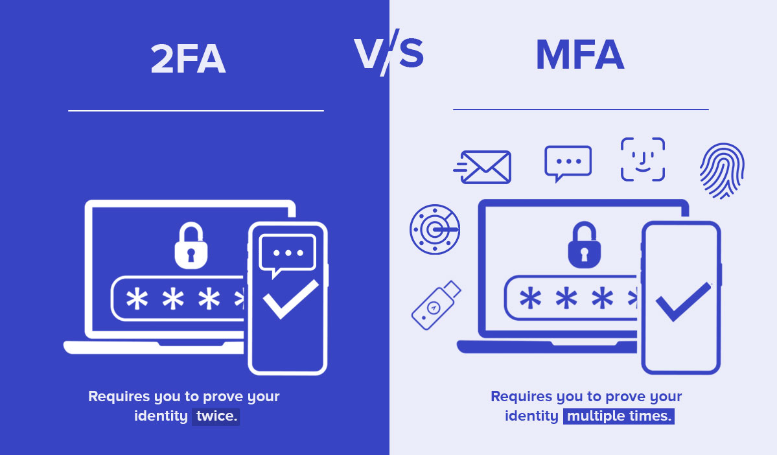
Image source: https://quicklaunch.io/two-factor-authentication-vs-multi-factor-authentication/

Slide 19


Slide 20
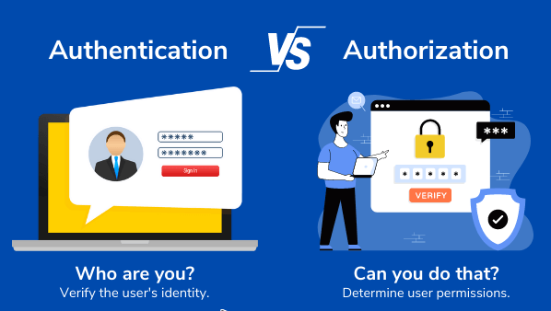
Website Security
are the measures taken to secure a website from cyberattacks.
If a website is hacked and block listed, for example, it loses up to 98% of its traffic.
Client data breach can result in lawsuits, heavy fines, and ruined reputation.
Cybersecurity
Authentication
Authorization
Image source: https://heimdalsecurity.com/blog/authentication-vs-authorization/

Slide 21
Website Security Vulnerabilities
Web security vulnerabilities are prioritized depending on exploitability, detectability, and impact on software
Exploitability
What is needed to exploit the security vulnerability? The highest exploitability is when the attack needs only a web browser and the lowest is advanced programming and tools.
Detectability
How easy is it to detect the threat? The highest is the information displayed on the URL, Form or Error message and the lowest is the source code.
Impact or Damage
How much damage will be done if the security vulnerability is exposed or attacked? The highest being a complete system crash and the lowest being nothing at all.

Slide 22
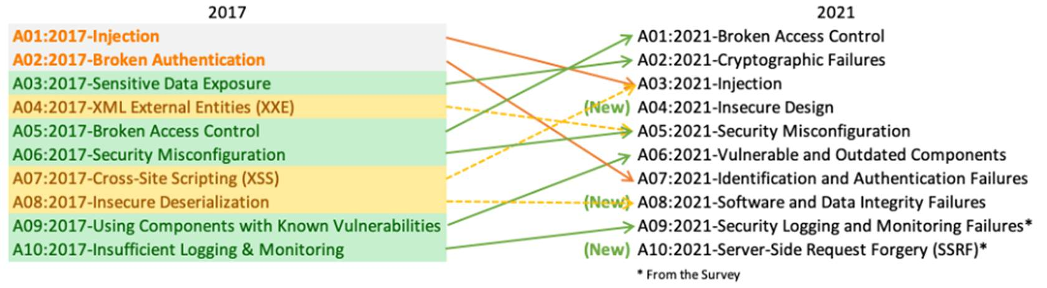
OWASP Foundation
The Open Web Application Security Project® (OWASP) is a non-profit foundation that works to improve the security of software.
Tools and Resources
Community and Networking
Education & Training
OWASP Top 10: is a regularly updated report outlining the top 10 most critical security risks to web applications.
The list is based on data from numerous security experts and organizations worldwide.
Here is the top 10 showing the change from 2017 to 2021:

Slide 23
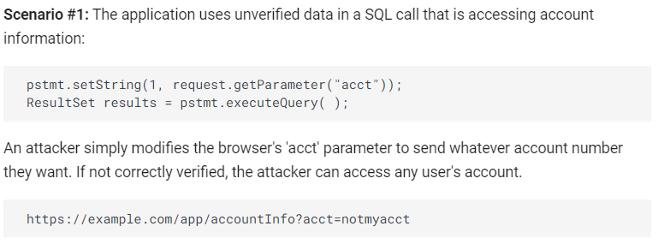
A01:2021 – Broken Access Control
Access control – enforces policy that users cannot act outside their intended permissions.
Failures typically lead to unauthorised information disclosure, modification, or destruction of all data or performing a business function outside the user's limits.
https://owasp.org/Top10/A01_2021-Broken_Access_Control/
Notes:
How to Prevent
Access control is only effective in trusted server-side code or server-less API, where the attacker cannot modify the access control check or metadata.
Except for public resources, deny by default.
Implement access control mechanisms once and re-use them throughout the application, including minimizing Cross-Origin Resource Sharing (CORS) usage.
Model access controls should enforce record ownership rather than accepting that the user can create, read, update, or delete any record.
Unique application business limit requirements should be enforced by domain models.
Disable web server directory listing and ensure file metadata (e.g., .git) and backup files are not present within web roots.
Log access control failures, alert admins when appropriate (e.g., repeated failures).
Rate limit API and controller access to minimize the harm from automated attack tooling.
Stateful session identifiers should be invalidated on the server after logout. Stateless JWT tokens should rather be short-lived so that the window of opportunity for an attacker is minimized. For longer lived JWTs it's highly recommended to follow the OAuth standards to revoke access.

Slide 24
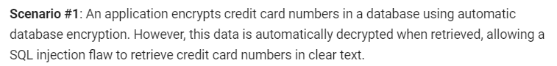
A02:2021 – Cryptographic Failures
Previously known as Sensitive Data Exposure
Cryptographic Failures – the focus is on failures related to cryptography (or lack thereof).
Determine the protection needs of data in transit and at rest.
For example, passwords, credit card numbers, health records, personal information, and business secrets require extra protection, mainly if that data falls under privacy laws, e.g., EU's General Data Protection Regulation (GDPR), or regulations, e.g., financial data protection such as PCI Data Security Standard (PCI DSS).
https://owasp.org/Top10/A02_2021-Cryptographic_Failures/
Notes:
How to Prevent
Do the following, at a minimum, and consult the references:
Classify data processed, stored, or transmitted by an application. Identify which data is sensitive according to privacy laws, regulatory requirements, or business needs.
Don't store sensitive data unnecessarily. Discard it as soon as possible or use PCI DSS compliant tokenization or even truncation. Data that is not retained cannot be stolen.
Make sure to encrypt all sensitive data at rest.
Ensure up-to-date and strong standard algorithms, protocols, and keys are in place; use proper key management.
Encrypt all data in transit with secure protocols such as TLS with forward secrecy (FS) ciphers, cipher prioritization by the server, and secure parameters. Enforce encryption using directives like HTTP Strict Transport Security (HSTS).
Disable caching for response that contain sensitive data.
Apply required security controls as per the data classification.
Do not use legacy protocols such as FTP and SMTP for transporting sensitive data.
Store passwords using strong adaptive and salted hashing functions with a work factor (delay factor), such as Argon2, scrypt, bcrypt or PBKDF2.
Initialization vectors must be chosen appropriate for the mode of operation. For many modes, this means using a CSPRNG (cryptographically secure pseudo random number generator). For modes that require a nonce, then the initialization vector (IV) does not need a CSPRNG. In all cases, the IV should never be used twice for a fixed key.
Always use authenticated encryption instead of just encryption.
Keys should be generated cryptographically randomly and stored in memory as byte arrays. If a password is used, then it must be converted to a key via an appropriate password base key derivation function.
Ensure that cryptographic randomness is used where appropriate, and that it has not been seeded in a predictable way or with low entropy. Most modern APIs do not require the developer to seed the CSPRNG to get security.
Avoid deprecated cryptographic functions and padding schemes, such as MD5, SHA1, PKCS number 1 v1.5 .
Verify independently the effectiveness of configuration and settings.

Slide 25
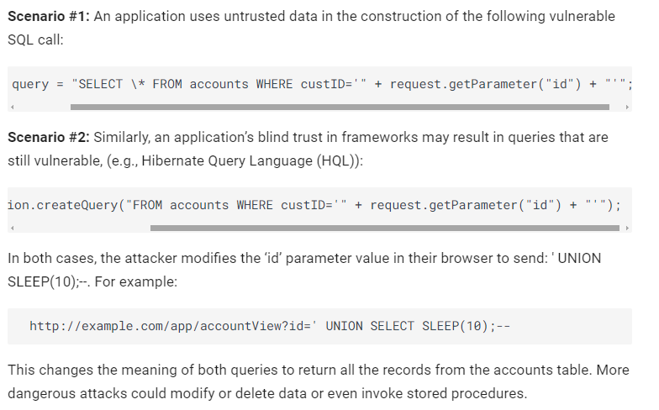
A03:2021 – Injection
An application is vulnerable to attack when:
User-supplied data is not validated, filtered, or sanitised by the application.
Dynamic queries or non-parameterized calls without context-aware escaping are used directly in the interpreter.
Hostile data is used within object-relational mapping (ORM) search parameters to extract additional, sensitive records.
Hostile data is directly used or concatenated. The SQL or command contains the structure and malicious data in dynamic queries, commands, or stored procedures.
https://owasp.org/Top10/A03_2021-Injection/
Notes:
How to Prevent
Preventing injection requires keeping data separate from commands and queries:
The preferred option is to use a safe API, which avoids using the interpreter entirely, provides a parameterized interface, or migrates to Object Relational Mapping Tools (ORMs). Note: Even when parameterized, stored procedures can still introduce SQL injection if PL/SQL or T-SQL concatenates queries and data or executes hostile data with EXECUTE IMMEDIATE or exec().
Use positive server-side input validation. This is not a complete defense as many applications require special characters, such as text areas or APIs for mobile applications.
For any residual dynamic queries, escape special characters using the specific escape syntax for that interpreter. Note: SQL structures such as table names, column names, and so on cannot be escaped, and thus user-supplied structure names are dangerous. This is a common issue in report-writing software.
Use LIMIT and other SQL controls within queries to prevent mass disclosure of records in case of SQL injection.

Slide 26

A04:2021 – Insecure Design
Insecure design – is a broad category representing different weaknesses, expressed as “missing or ineffective control design.”
lack of business risk profiling inherent in the software/system being developed, and thus the failure to determine what level of security design is required.
https://owasp.org/Top10/A04_2021-Insecure_Design/
Notes:
How to Prevent
Establish and use a secure development lifecycle with AppSec professionals to help evaluate and design security and privacy-related controls
Establish and use a library of secure design patterns or paved road ready to use components
Use threat modeling for critical authentication, access control, business logic, and key flows
Integrate security language and controls into user stories
Integrate plausibility checks at each tier of your application (from frontend to backend)
Write unit and integration tests to validate that all critical flows are resistant to the threat model. Compile use-cases and misuse-cases for each tier of your application.
Segregate tier layers on the system and network layers depending on the exposure and protection needs
Segregate tenants robustly by design throughout all tiers
Limit resource consumption by user or service

Slide 27
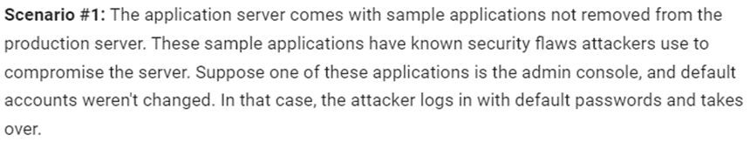
A05:2021 – Security Misconfiguration
Missing appropriate security across any part of the application stack or improperly configured permissions.
Unnecessary features are enabled or installed (e.g., unnecessary ports, services, pages, accounts, or privileges).
Default accounts and their passwords are still enabled and unchanged.
Error handling reveals stack traces or other overly informative error messages to users.
The server does not send security headers or directives, or they are not set to secure values.
The software is out of date or vulnerable (see A06:2021-Vulnerable and Outdated Components).
https://owasp.org/Top10/A05_2021-Security_Misconfiguration/
Notes:
How to Prevent
Secure installation processes should be implemented, including:
A repeatable hardening process makes it fast and easy to deploy another environment that is appropriately locked down. Development, QA, and production environments should all be configured identically, with different credentials used in each environment. This process should be automated to minimize the effort required to set up a new secure environment.
A minimal platform without any unnecessary features, components, documentation, and samples. Remove or do not install unused features and frameworks.
A task to review and update the configurations appropriate to all security notes, updates, and patches as part of the patch management process (see A06:2021-Vulnerable and Outdated Components). Review cloud storage permissions (e.g., S3 bucket permissions).
A segmented application architecture provides effective and secure separation between components or tenants, with segmentation, containerization, or cloud security groups (ACLs).
Sending security directives to clients, e.g., Security Headers.
An automated process to verify the effectiveness of the configurations and settings in all environments.

Slide 28
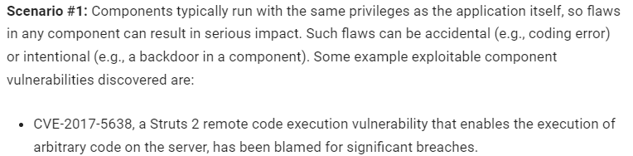
A06:2021 – Vulnerable and Outdated Components
If the software is vulnerable, unsupported, or out of date. This includes the OS, web/application server, database management system (DBMS), applications, APIs and all components, runtime environments, and libraries.
If you do not scan for vulnerabilities regularly and subscribe to security bulletins related to the components, you use.
If you do not fix or upgrade the underlying platform, frameworks, and dependencies in a risk-based, timely fashion.
If software developers do not test the compatibility of updated, upgraded, or patched libraries.
https://owasp.org/Top10/A06_2021-Vulnerable_and_Outdated_Components/
Notes:
How to Prevent
There should be a patch management process in place to:
Remove unused dependencies, unnecessary features, components, files, and documentation.
Continuously inventory the versions of both client-side and server-side components (e.g., frameworks, libraries) and their dependencies using tools like versions, OWASP Dependency Check, retire.js, etc. Continuously monitor sources like Common Vulnerability and Exposures (CVE) and National Vulnerability Database (NVD) for vulnerabilities in the components. Use software composition analysis tools to automate the process. Subscribe to email alerts for security vulnerabilities related to components you use.
Only obtain components from official sources over secure links. Prefer signed packages to reduce the chance of including a modified, malicious component (See A08:2021-Software and Data Integrity Failures).
Monitor for libraries and components that are unmaintained or do not create security patches for older versions. If patching is not possible, consider deploying a virtual patch to monitor, detect, or protect against the discovered issue.
Every organization must ensure an ongoing plan for monitoring, triaging, and applying updates or configuration changes for the lifetime of the application or portfolio.

Slide 29
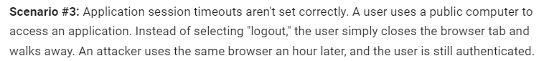
A07:2021 – Identification and Authentication Failures
Confirmation of the user's identity, authentication, and session management is critical to protect against authentication-related attacks. There may be authentication weaknesses if the application:
Permits automated attacks such as credential stuffing, where the attacker has a list of valid usernames and passwords.
Permits default, weak, or well-known passwords, such as "Password1" or "admin/admin".
Uses plain text, encrypted, or weakly hashed password data stores (see A02:2021-Cryptographic Failures).
Has missing or ineffective multi-factor authentication.
Exposes session identifier in the URL.
https://owasp.org/Top10/A07_2021-Identification_and_Authentication_Failures/
Notes:
How to Prevent
Where possible, implement multi-factor authentication to prevent automated credential stuffing, brute force, and stolen credential reuse attacks.
Do not ship or deploy with any default credentials, particularly for admin users.
Implement weak password checks, such as testing new or changed passwords against the top 10,000 worst passwords list.
Align password length, complexity, and rotation policies with National Institute of Standards and Technology (NIST) 800-63b's guidelines in section 5.1.1 for Memorized Secrets or other modern, evidence-based password policies.
Ensure registration, credential recovery, and API pathways are hardened against account enumeration attacks by using the same messages for all outcomes.
Limit or increasingly delay failed login attempts, but be careful not to create a denial of service scenario. Log all failures and alert administrators when credential stuffing, brute force, or other attacks are detected.
Use a server-side, secure, built-in session manager that generates a new random session ID with high entropy after login. Session identifier should not be in the URL, be securely stored, and invalidated after logout, idle, and absolute timeouts.

Slide 30
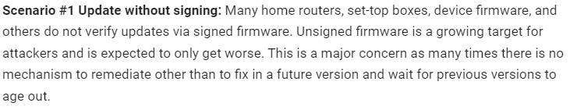
A08:2021 – Software and Data Integrity Failures
Software and data integrity failures relate to code and infrastructure that do not protect against integrity violations.
Many applications now include auto-update functionality, where updates are downloaded without sufficient integrity verification and applied to the previously trusted application.
Attackers could potentially upload their own updates to be distributed and run on all installations.
Objects or data are encoded or serialized into a structure that an attacker can see and modify is vulnerable to insecure deserialization.
https://owasp.org/Top10/A08_2021-Software_and_Data_Integrity_Failures/
Notes:
How to Prevent
Use digital signatures or similar mechanisms to verify the software or data is from the expected source and has not been altered.
Ensure libraries and dependencies, such as npm or Maven, are consuming trusted repositories. If you have a higher risk profile, consider hosting an internal known-good repository that's vetted.
Ensure that a software supply chain security tool, such as OWASP Dependency Check or OWASP CycloneDX, is used to verify that components do not contain known vulnerabilities
Ensure that there is a review process for code and configuration changes to minimize the chance that malicious code or configuration could be introduced into your software pipeline.
Ensure that your CI/CD pipeline has proper segregation, configuration, and access control to ensure the integrity of the code flowing through the build and deploy processes.
Ensure that unsigned or unencrypted serialized data is not sent to untrusted clients without some form of integrity check or digital signature to detect tampering or replay of the serialized data

Slide 31
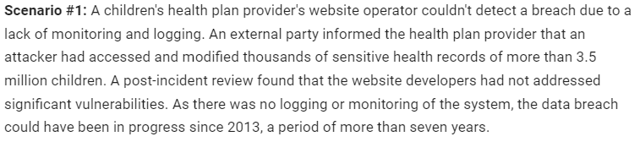
A09:2021 – Security Logging and Monitoring Failures
Security Logging and Monitoring Failures – is to help detect, escalate, and respond to active breaches. Without logging and monitoring, breaches cannot be detected.
Auditable events, such as logins, failed logins, and high-value transactions, are not logged.
Warnings and errors generate no, inadequate, or unclear log messages.
Logs of applications and APIs are not monitored for suspicious activity.
Appropriate alerting thresholds and response escalation processes are not in place or effective.
The application cannot detect, escalate, or alert for active attacks in real-time or near real-time.
https://owasp.org/Top10/A09_2021-Security_Logging_and_Monitoring_Failures/
Notes:
How to Prevent
Developers should implement some or all the following controls, depending on the risk of the application:
Ensure all login, access control, and server-side input validation failures can be logged with sufficient user context to identify suspicious or malicious accounts and held for enough time to allow delayed forensic analysis.
Ensure that logs are generated in a format that log management solutions can easily consume.
Ensure log data is encoded correctly to prevent injections or attacks on the logging or monitoring systems.
Ensure high-value transactions have an audit trail with integrity controls to prevent tampering or deletion, such as append-only database tables or similar.
DevSecOps teams should establish effective monitoring and alerting such that suspicious activities are detected and responded to quickly.
Establish or adopt an incident response and recovery plan, such as National Institute of Standards and Technology (NIST) 800-61r2 or later.
There are commercial and open-source application protection frameworks such as the OWASP ModSecurity Core Rule Set, and open-source log correlation software, such as the Elasticsearch, Logstash, Kibana (ELK) stack, that feature custom dashboards and alerting.

Slide 32
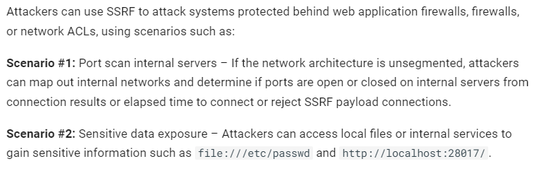
A10:2021 – Server-Side Request Forgery (SSRF)
SSRF flaws occur whenever a web application is fetching a remote resource without validating the user-supplied URL.
It allows an attacker to coerce the application to send a crafted request to an unexpected destination, even when protected by a firewall, VPN, or another type of network access control list (ACL).
As modern web applications provide end-users with convenient features, fetching a URL becomes a common scenario. As a result, the incidence of SSRF is increasing. Also, the severity of SSRF is becoming higher due to cloud services and the complexity of architectures.
https://owasp.org/Top10/A10_2021-Server-Side_Request_Forgery_%28SSRF%29/
Notes:
How to Prevent
Developers can prevent SSRF by implementing some or all the following defense in depth controls:
From Network layer
Segment remote resource access functionality in separate networks to reduce the impact of SSRF
Enforce “deny by default” firewall policies or network access control rules to block all but essential intranet traffic. Hints: ~ Establish an ownership and a lifecycle for firewall rules based on applications. ~ Log all accepted and blocked network flows on firewalls (see A09:2021-Security Logging and Monitoring Failures).
From Application layer:
Sanitize and validate all client-supplied input data
Enforce the URL schema, port, and destination with a positive allow list
Do not send raw responses to clients
Disable HTTP redirections
Be aware of the URL consistency to avoid attacks such as DNS rebinding and “time of check, time of use” (TOCTOU) race conditions
Do not mitigate SSRF via the use of a deny list or regular expression. Attackers have payload lists, tools, and skills to bypass deny lists.
Additional Measures to consider:
Don't deploy other security relevant services on front systems (e.g. OpenID). Control local traffic on these systems (e.g. localhost)
For frontends with dedicated and manageable user groups use network encryption (e.g. VPNs) on independent systems to consider very high protection needs

Slide 33
ICTWEB513 – Build Dynamic Websites
1.4 - Web programming concepts: Hypertext Transfer Protocol (HTTP)

Slide 34
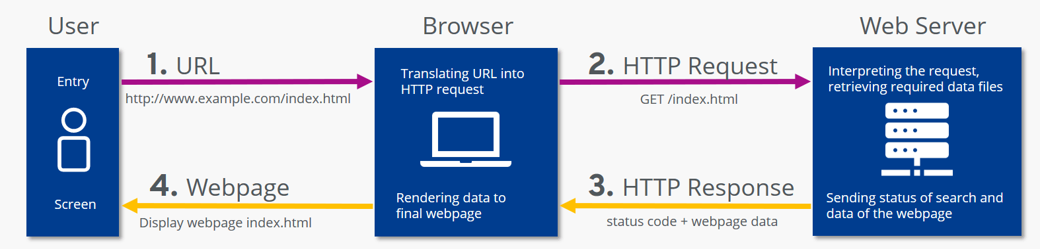
Hypertext Transfer Protocol (HTTP)
is the foundation of WWW and is used to load web pages (such as HTML documents) via hypertext links.
is an application layer protocol that operates on top of other layers of the network protocol stack to convey data between networked devices
HTTPS – it means that the protocol being used is working with SSL(TLS) as a sub-layer on HTTP.
HTTPS – encrypts and decrypts both user HTTP page requests and the web server’s response pages.
Notes:
A web server contains an HTTP daemon (a program that listens for HTTP requests and responses and handles them as they come in). When a user tries to visit a webpage (typing the URL), at that time the browser builds an HTTP request and sends it to the IP address pointed by the URL. The request is received by the HTTP daemon on the destination server, which then sends back the requested file or files.

Slide 35
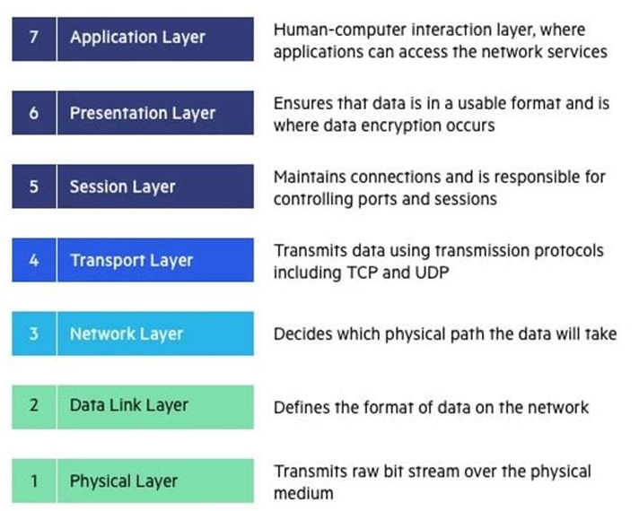
Networking Basics – The OSI Model
Software Layers
is a reference model that describes how information from a software application in one computer moves through a physical medium to the software application in another computer.
contains seven layers – The OSI model divides a whole task into seven sub-tasks, where each layer performs the task assigned independently.
the modern Internet is not based on OSI, but on the simpler TCP/IP model.
The OSI 7-layer model is still widely used – it helps visualize and communicate how networks operate and helps isolate and troubleshoot networking problems
Heart of OSI
Hardware Layers

Slide 36
The OSI Model
The OSI model helps users and operators of computer networks to do the following things:
Determine the required hardware and software to build their network.
Understand and communicate the process followed by components communicating across a network.
Perform troubleshooting, by identifying which network layer is causing an issue and focusing efforts on that layer.

Slide 37
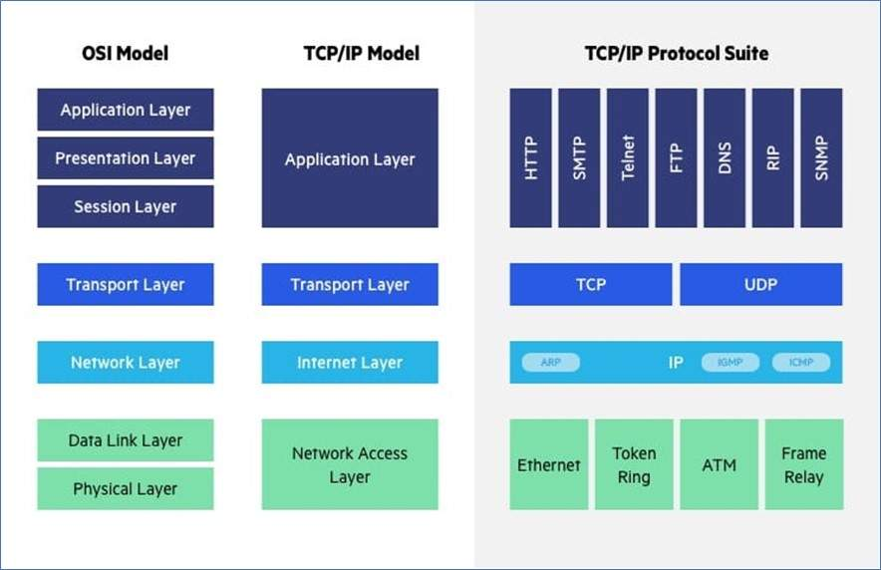
OSI vs TCP/IP
OSI layers 5, 6, and 7 are combined into one Application Layer in TCP/IP
OSI layers 1, and 2 are combined into one Network Access Layer in TCP/IP
TCP/IP is a functional model designed to solve specific communication problems, and which is based on specific, standard protocols. OSI is a generic, protocol-independent model intended to describe all forms of network communication.
In TCP/IP, most applications use all the layers, while in OSI simple applications do not use all seven layers. Only layers 1, 2 and 3 are mandatory to enable any data communication.

Slide 38
ICTWEB513 – Build Dynamic Websites
1.5 – Web programming concepts: Session Management

Slide 39
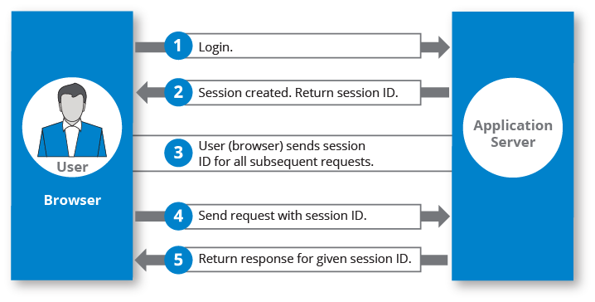
Session Management
manages sessions between the web application and the users.
When a user visits a website, a session is made containing multiple requests and responses over HTTP.
Web session is a sequence of network HTTP request and response transactions associated with the same user.
HTTP is a stateless protocol – each request and response are independent of other web processes.
web applications can provide session capabilities for both pre-authentication and post-authentication.
apply security access controls, authorized access to the user’s private data and increase application usability

Slide 40
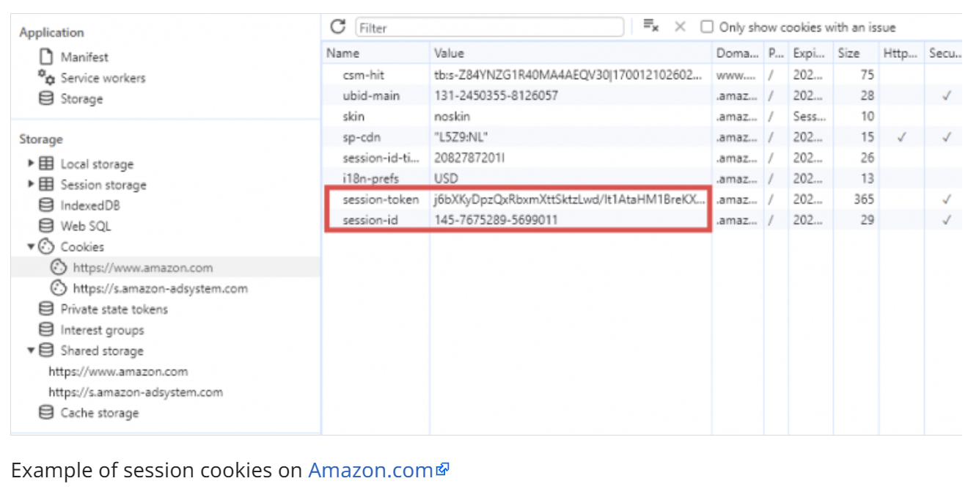
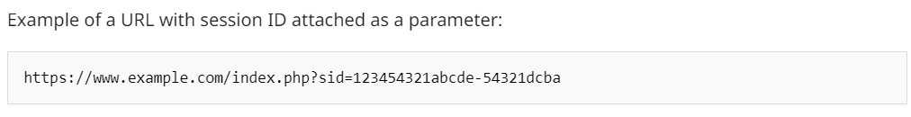
Session ID (SID)
is a unique number a server assigns to requesting clients – used to identify and track user activity.
can be a number code, numerical code, or alphanumeric code
the session ID or token binds the user authentication credentials (in the form of a user session) to the user HTTP traffic and the appropriate access controls are enforced by the web application.
Session IDs are transmitted via:
Cookies
URL parameter
Hidden Form Field

Slide 41
Session ID (SID) – Use Cases
User authentication: ensures that users stay authenticated post-login, as they navigate through different parts of a website or application.
Shopping carts in E-commerce: keeps track of items a user has added to their cart, even if they navigate away from the page.
Personalization: to remember user preferences and deliver a personalized experience.
Analytics and tracking: helps tracking user behaviour on a website – used for analytics and to offer customized user experience
State management in web apps: keeps track of user activities and choices in web applications, particularly when the communication between the user's device and the server does not automatically remember previous interactions.

Slide 42
